Slide 1
CHGM-141
General and Analytical Chemistry
Lecture 4(a)
(Ch. 1) with Dr. Bailey
The Structure of Atoms
Protons, Electrons, and Neutrons
Atomic number and Atomic Mass
Isotopes
Atomic Weight
Nuclear Change and Radioactivity

Slide 2
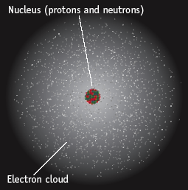
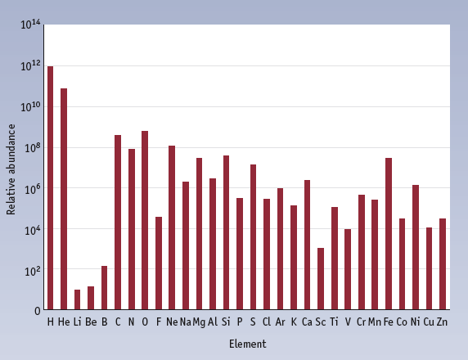
ATOMS AND ELEMENTS

Slide 3
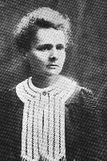
Radioactivity
One of the pieces of evidence for the fact that atoms are made of smaller particles came from the work of Marie Curie (1876-1934).
She discovered radioactivity, the spontaneous disintegration of some elements into smaller pieces.
So atoms are NOT indestructible
Atoms are made up of some charged species…

Slide 4
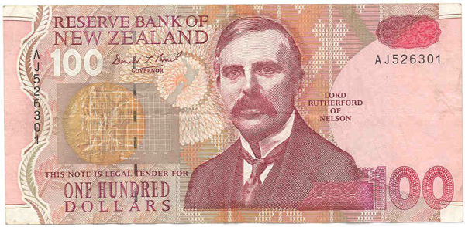
The modern view of the atom was developed by Ernest Rutherford of New Zealand (1871-1937).

Slide 5
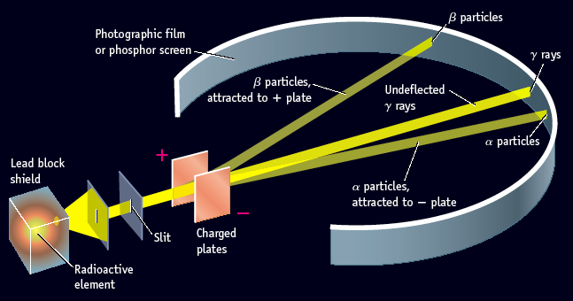
Types of Radioactive Emissions
Three types of radiation were discovered by Ernest Rutherford :
  α particles
  β particles
  γ rays
So what exactly is the atom made up of?
Notes:
Figure 2.8

Slide 6
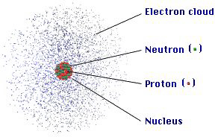
ATOMIC COMPOSITION
Subatomic Particles
Atoms are NOT indestructible
Atoms are made up of some species…
Protons
Electrons
Neutrons
Notes:
Table 2.1

Slide 7
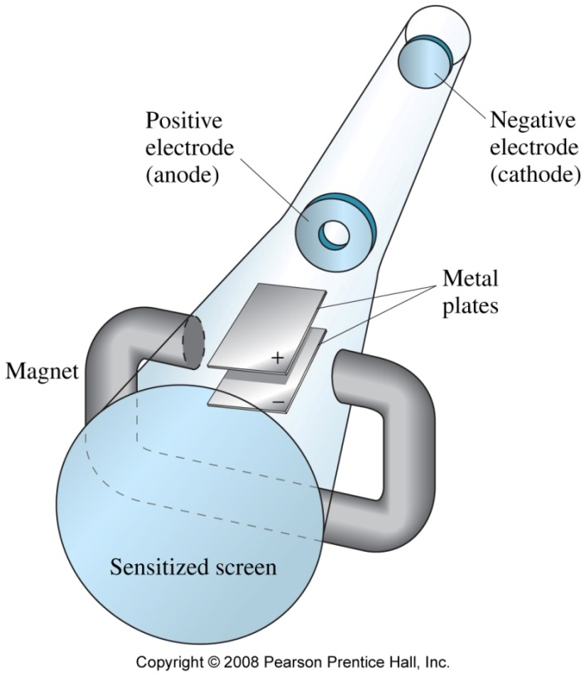
The Structure of Atoms: Electrons
Cathode-Ray Tubes: J. J. Thomson (1856-1940) proposed that cathode rays must consist of tiny negatively charged particles. We now call them electrons.

Slide 8
The Structure of Atoms: Discovery of the Nucleus
Atomic Nucleus: Ernest Rutherford (1871-1937) bombarded gold foil with alpha particles. Although most of the alpha particles passed through the foil undeflected, approximately 1 in every 20,000 particles were deflected. A fraction of those particles were deflected back at an extreme angle.
Rutherford proposed that the atom must consist mainly of empty space with the mass concentrated in a tiny central core—the nucleus.
Notes:
To get a sense of scale, think of a pea in any typical sports stadium. The pea is the relative size of the nucleus.

Slide 9
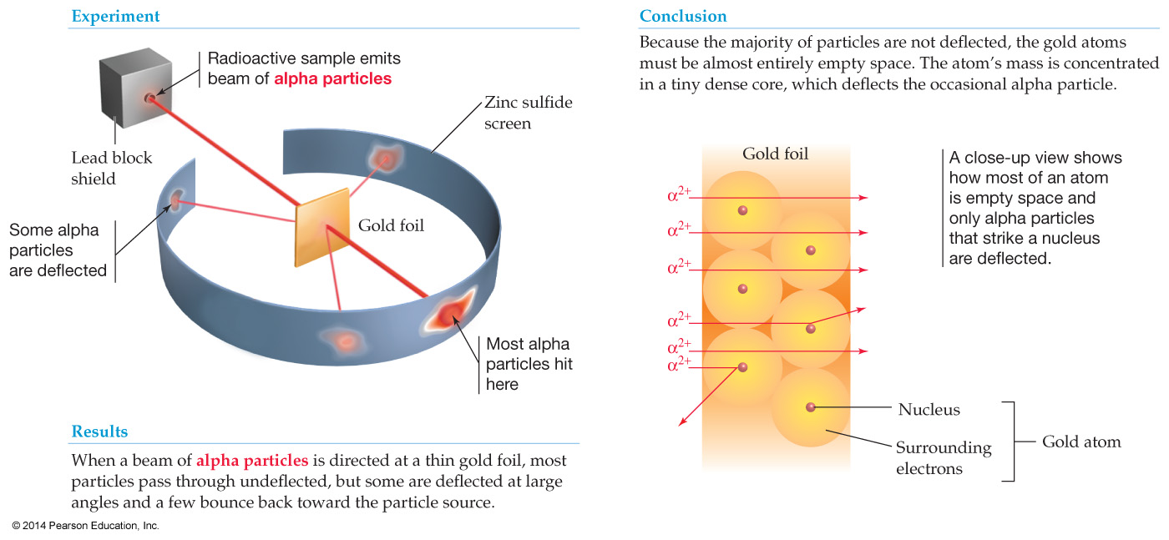
The Structure of Atoms: Protons and Neutrons
Rutherford proposed that the atom must consist mainly of empty space with the mass concentrated in a tiny central core—the nucleus.
Rutherford’s Scattering Experiment
Notes:
Chapter 2: The Structure and Stability of Atoms
Copyright © 2010 Pearson Prentice Hall, Inc.

Slide 10
Other Subatomic Particles
Protons were discovered by Rutherford in 1919.
Neutrons were discovered by James Chadwick in 1932.
We now have the modern day view of the atom…

Slide 11
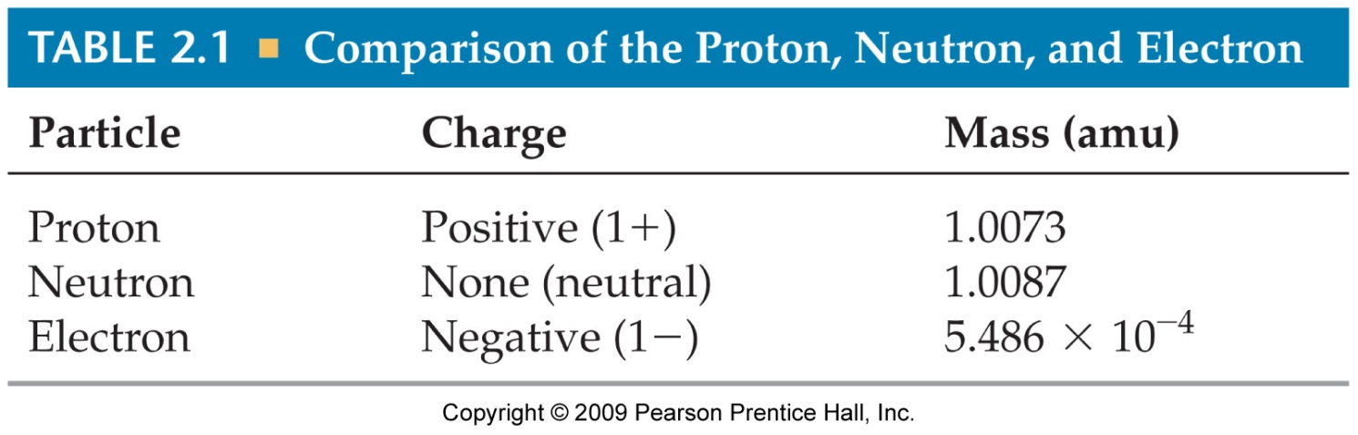
ATOMIC COMPOSITION
Subatomic Particles
Protons
Electrons
Neutrons
Protons and electrons are the only particles that have a charge.
Protons and neutrons have essentially the same mass.
The mass of an electron is so small we ignore it.
Notes:
Table 2.1

Slide 12
ATOM
COMPOSITION
protons and neutrons in the nucleus.
the number of electrons is equal to the number of protons (so atoms have no net electrical charge).
electrons in space around the nucleus.
extremely small. One teaspoon of water has 3 times as many atoms as the Atlantic Ocean has teaspoons of water.

Slide 13
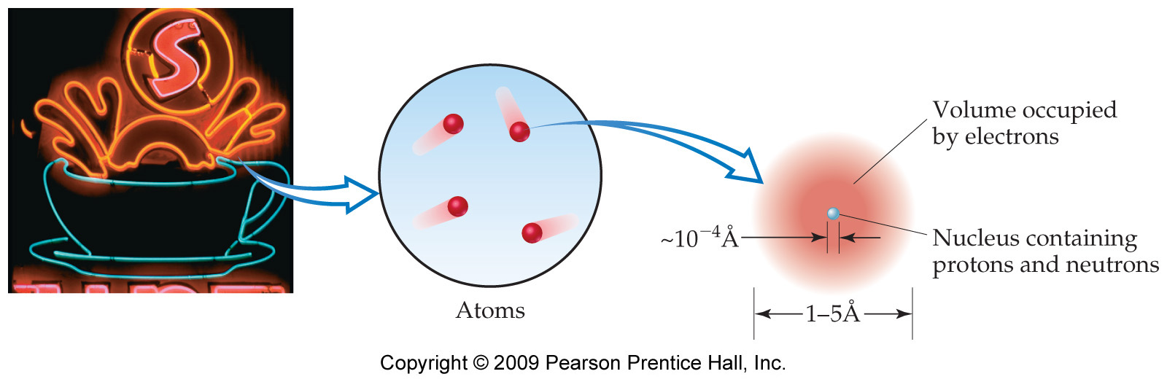
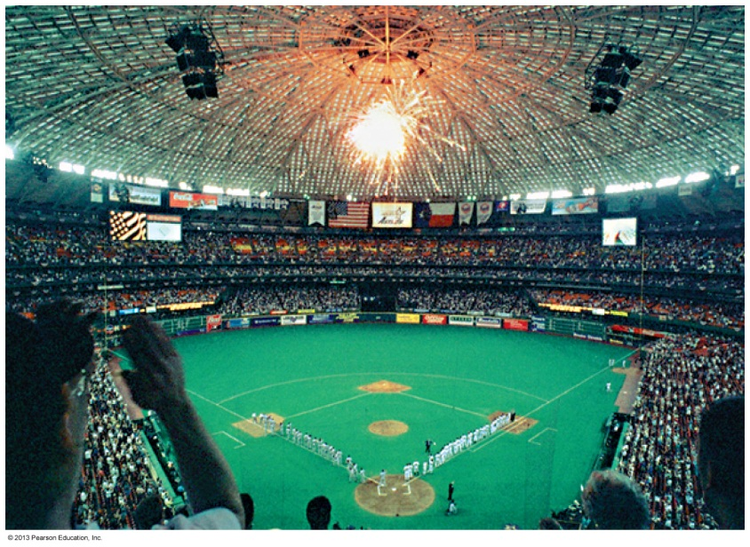
Most of the volume of the atom is empty space
The relative size of a nucleus in an atom is the same as that of a pea in the middle of this stadium.
2009, Prentice-Hall, Inc.
Notes:
Figure 2.12

Slide 14
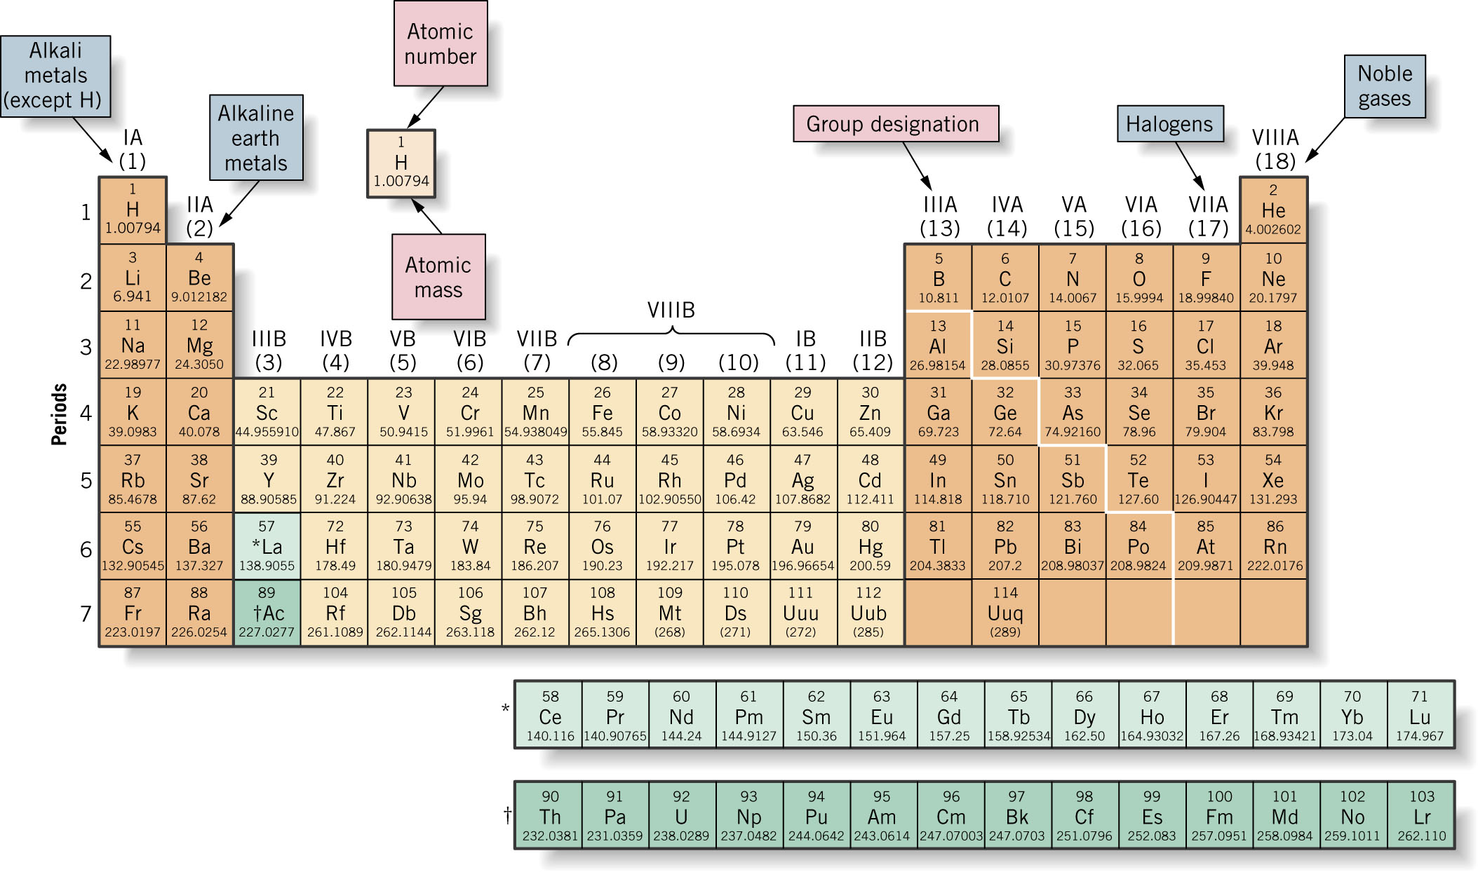

Slide 15
Atomic Number, Z
All atoms of the same element have the same number of protons in the nucleus, Z
13
Atomic number
Al
Atom symbol
26.981
Atomic weight

Slide 17
An element can be defined as a substance whose atoms all contain identical # of protons, called the atomic number (Z)

Slide 18
And…For charge neutrality, the number of electrons and protons must be equal

Slide 19
Of the three major subatomic particles, the least massive is a:
10
Proton
Electron
Neutron
0
of
5

Slide 20
The terms “mass” and “weight”
Really have quite different meaning
Mass is a measure of the amount of matter in an object
Weight is a measure of the gravitation force that the earth, moon, or other larger body exerts on an object
The amount of matter (mass) in an object does not depend on location
The weight of an object does depend on location
At the same location, two objects with identical masses have identical weights
The terms “mass’ and “weight” often used interchangeably
What is the mass of an atom?

Slide 21
Atomic Weight
This tells us the mass of one atom of an element relative to one atom of another element.
OR — the mass of 1000 atoms of one relative to 1000 atoms of another.
For example, an O atom is approximately 16 times heavier than an H atom.

Slide 23
What units do we use for Atomic Mass?
Define one element as the standard against which all others are measured
Standard = carbon

Slide 24
After trying several standards, scientists settled on the current one:
For atomic mass units (amu, or u) the standard is based on carbon:
C atom with 6 protons and 6 neutrons is mass standard
    1 atom of carbon with 6 protons and 6 neutrons = 12 u (exactly)
    1 u = 1/12 mass 1 atom of carbon-12 (exactly)
    1u = 1.661 x 10-24 g (the atomic mass unit can be related to other units of mass using a conversion factor
    Why C? (H, He, Li, Be, B either gaseous or react!)

Slide 25
Mass Number
Proton and neutrons have masses very close to 1 u
The electron in contrast, has a mass only about 1/2000 of this value
The approximate mass of an atom can be estimated if the number of neutrons and protons is known
The sum of the number of protons and neutrons for an atom is called its mass number (symbol A)

Slide 26
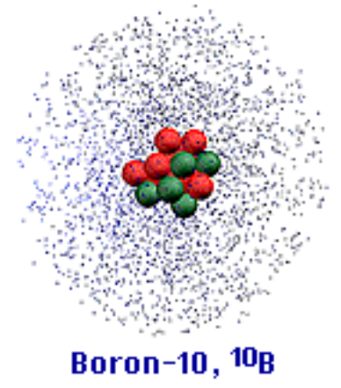
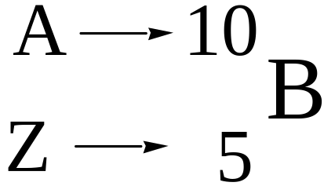
Mass Number, A
Mass Number (A) = # protons + # neutrons
A boron atom can have A = 5 p + 5 n = 10 u

Slide 27
And…For charge neutrality, the number of electrons and protons must be equal

Slide 28
Atomic Number
carbon-12
mass number
12
6 protons
6 electrons
6 neutrons
C
6
atomic number
carbon-14
mass number
14
6 protons
6 electrons
8 neutrons
C
6
atomic number
Notes:
Carbon-14 is used for radioactive dating. The carbon dating of the Shroud of Turin can be an interesting discussion.

Slide 29
  E.g.: For uranium-235
    # of protons = 92 ( = number of electrons)
    # of neutrons = 143
    Atomic number (Z) = 92
    Mass number (A) = 92 + 143 = 235
    Chemical symbol = U
Summary for uranium-235:
Mass number, A (protons + neutrons) →
Chemical Symbol →
Atomic number, Z (number of protons) →
235
U
92

Slide 30
Isotopes
Actually most elements in nature are uniform mixtures of two or more kinds of atoms with slightly different masses
Atoms of same element with different masses are called isotopes
    E.g. there are 3 isotopes of hydrogen and 4 isotopes of iron
Chemically, isotopes have virtually identical chemical properties
Relative proportions of different isotopes are essentially constant

Slide 31
Isotopes are distinguished by Mass Number, A
A = (number of protons) + (number of neutrons)

Slide 32
Isotope Composition
Isotope | Electrons | Protons | Neutrons
Sulfur-32
Bromine-79
16
16
16
35
35
44

Slide 33
Isotope Composition
Isotope | Electrons | Protons | Neutrons
Sulfur-32 |  | 16
Sulfur-31

Slide 34
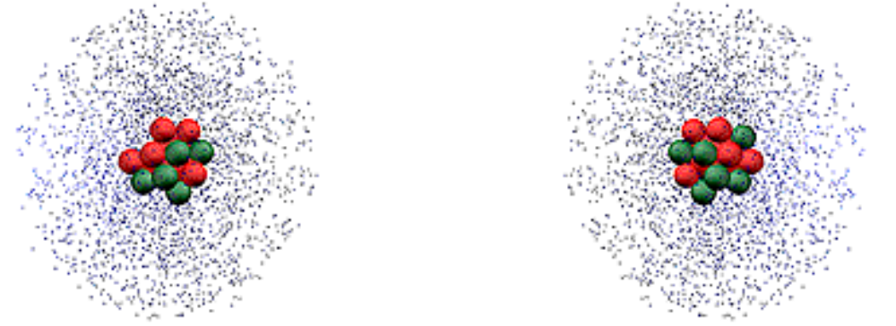
Isotopes
¹¹B
¹⁰B
Because of the existence of isotopes, the mass of a collection of atoms has an average value.
Average mass = ATOMIC WEIGHT

Slide 35
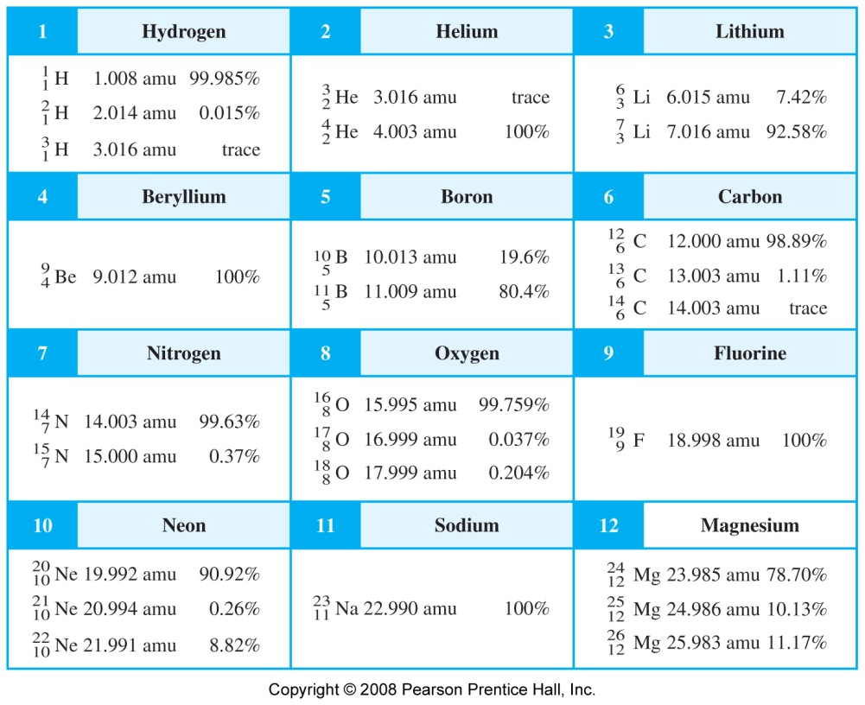
Isotopic Data for Elements with Atomic Numbers 1 through 12

Slide 36


Atomic Mass
Why is the atomic mass of the element carbon 12.01 amu?
carbon-12: 98.89 % natural abundance 12 amu
carbon-13: 1.11 % natural abundance 13.0034 amu
Atomic weight = x (mass of isotope 1) +
+ x (mass of isotope 2) + …..
mass of carbon = (0.9889)(12 amu) + (0.0111) (13.0034 amu)
= 11.87 amu + 0.144 amu
= 12.01 amu

Slide 37
Anather example:
Naturally occurring chlorine is a mixture of two isotopes.
    In every sample of this element, 75.77% of the atoms are chlorine-35 and 24.23% are chlorine-37.
    The measured mass of chlorine-35 is 34.9689 u and that of chlorine-37 is 36.9659 u.
    Calculate the average atomic mass of chlorine.
Abundance Mass
Isotope (%) (u) Contribution
Chlorine-35 75.77 34.9689 0.7577 * 34.9689 = 26.50 u
Chlorine-37 24.23 36.9659 0.2423 * 36.9659 = 8.957 u
(Rounded) Total = 35.46 u

Slide 38
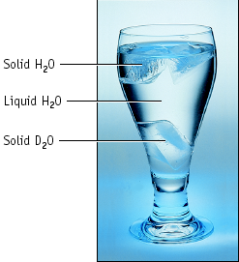
Hydrogen Isotopes
Hydrogen has _____ isotopes
1 proton and 0 neutrons, protium
¹₁H
1 proton and 1 neutron, deuterium
²₁H
1 proton and 2 neutrons, tritium
radioactive
³₁H

Slide 39
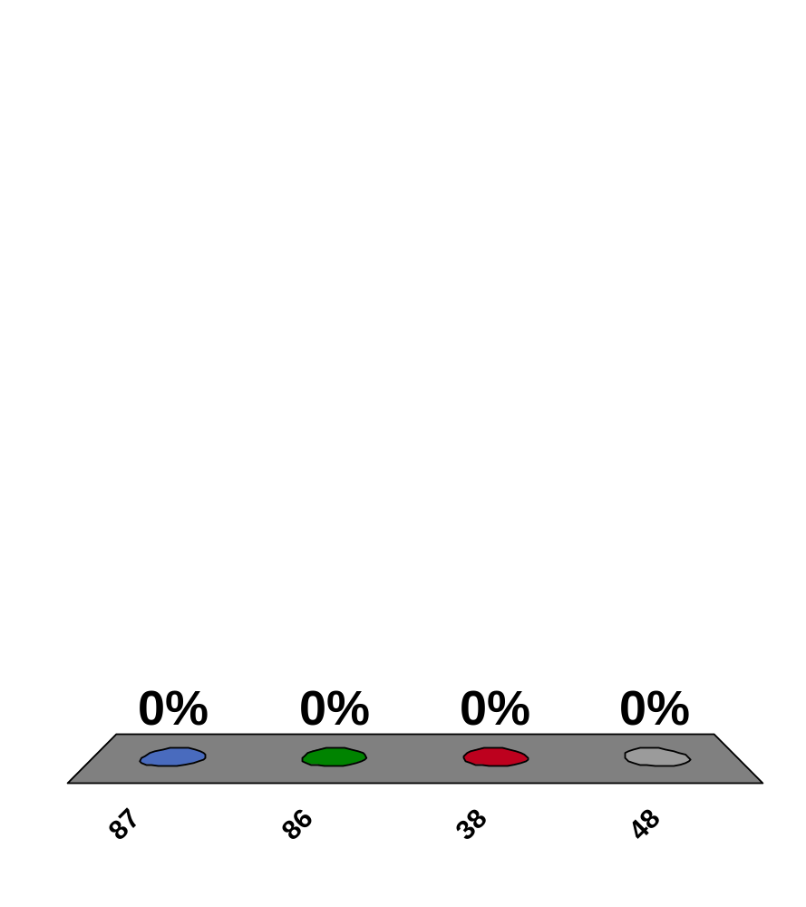
How many protons does ⁸⁶Sr have?
87
86
38
48
25
0
of
5

Slide 40
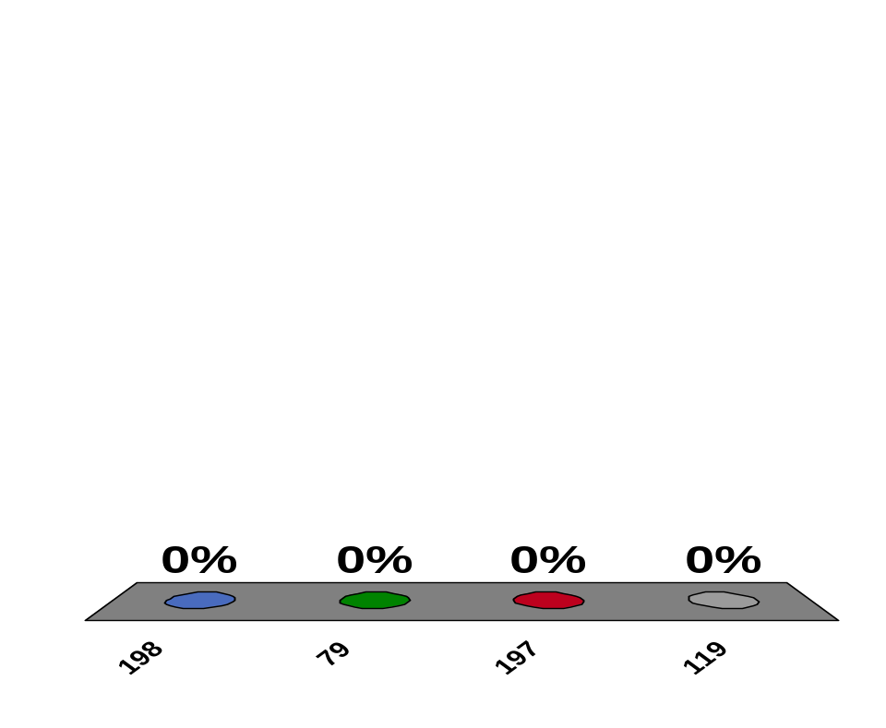
How many neutrons does ¹⁹⁸Au have?
198
79
197
119
25
1 | 2 | 3 | 4 | 5

Slide 41
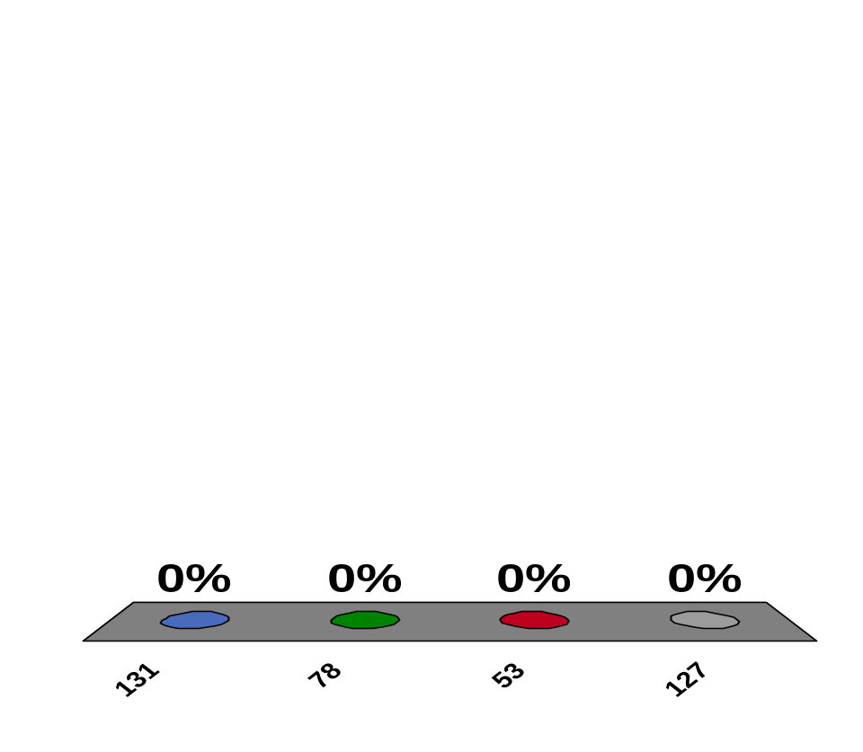
How many neutrons does ¹³¹I have?
131
78
53
127
25
1 | 2 | 3 | 4 | 5

Slide 42
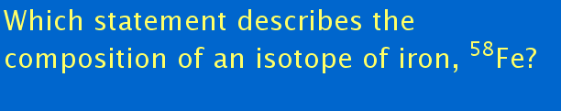
Enter question text...
10
26 neutrons, 32 protons, and 26 electrons
32 neutrons, 26 protons, and 26 electrons
26 neutrons, 26 protons, and 32 electrons
26 neutrons, 26 protons, and 26 electrons
0
of
5

Slide 43
Which of the following is NOT an isotope of element X, the atomic number for which is 9?
¹⁹₉X
²⁰₁₀X
¹⁸₉X
219X
9
0
of
5

Slide 44
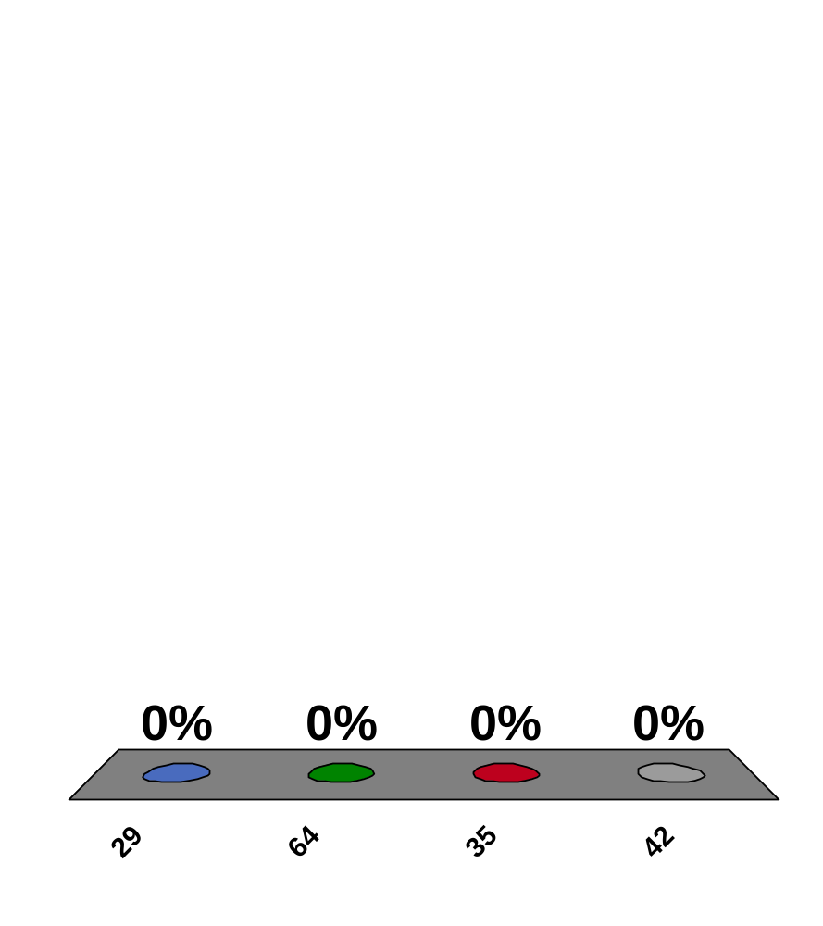
How many electrons does ⁶⁴Cu have?
29
64
35
42
10
0
of
5

Slide 46
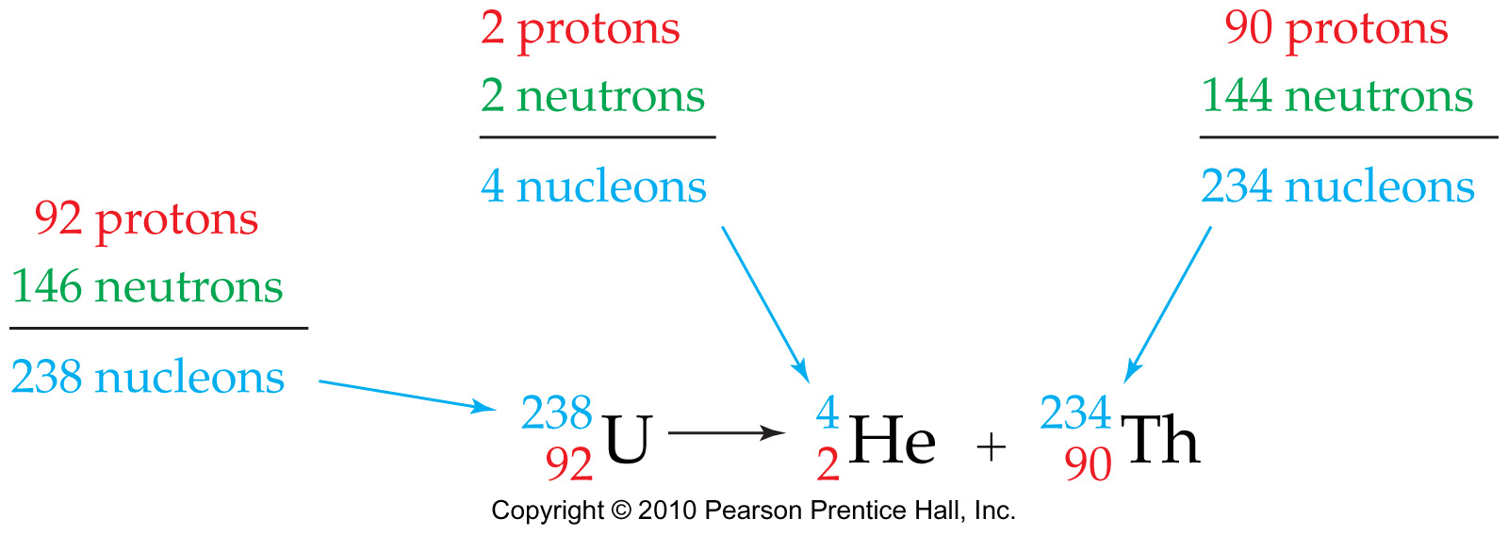
Nuclear Chemistry: The Change of One Element to Another
Nuclear Chemistry: The study of the properties and changes of atomic nuclei.
Nuclear Reaction: A reaction that changes an atomic nucleus.
Notes:
Chapter 2: The Structure and Stability of Atoms
Copyright © 2010 Pearson Prentice Hall, Inc.

Slide 47
Nuclear Chemistry: The Change of One Element to Another
Comparisons Between Nuclear and Chemical Reactions
A nuclear reaction changes an atom’s nucleus.
A chemical reaction only involves a change in the way that different atoms are combined.
Different isotopes of an elements have essentially the same behavior in chemical reactions, but often have completely different behavior in nuclear reactions.
The energy change accompanying a nuclear reaction is far greater than that accompanying a chemical reaction.
Notes:
Chapter 2: The Structure and Stability of Atoms
Copyright © 2010 Pearson Prentice Hall, Inc.
The nuclear transformation of 1 g uranium-235 releases 8.2 × 10⁷ kJ while the chemical combustion of 1 g of methane releases 56 kJ.

Slide 48
Nuclear Change and Radioactivity
Radioactivity: The spontaneous decay and emission of radiation from an unstable nucleus.
Radioisotope: A radioactive isotope.
Notes:
Chapter 2: The Structure and Stability of Atoms
Copyright © 2010 Pearson Prentice Hall, Inc.

Slide 49
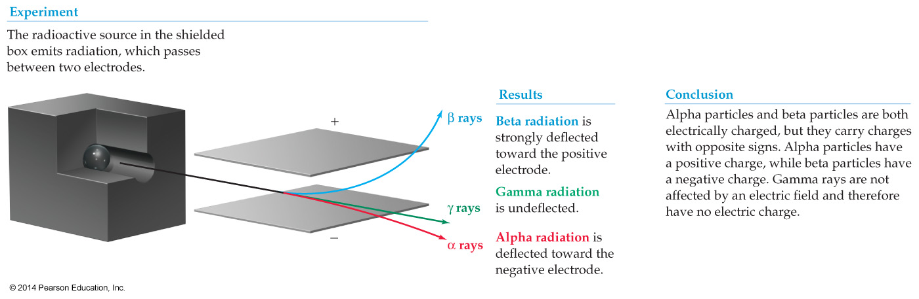
Nuclear Change and Radioactivity
Notes:
Chapter 2: The Structure and Stability of Atoms
Copyright © 2010 Pearson Prentice Hall, Inc.

Slide 50
Nuclear Change and Radioactivity
Alpha (α) Radiation
An alpha particle is a helium-4 nucleus (2 protons and 2 neutrons).
Alpha particle, α
Notes:
Chapter 2: The Structure and Stability of Atoms
Copyright © 2010 Pearson Prentice Hall, Inc.
Note that in a nuclear reaction, the total number of nucleons must be conserved.

Slide 51
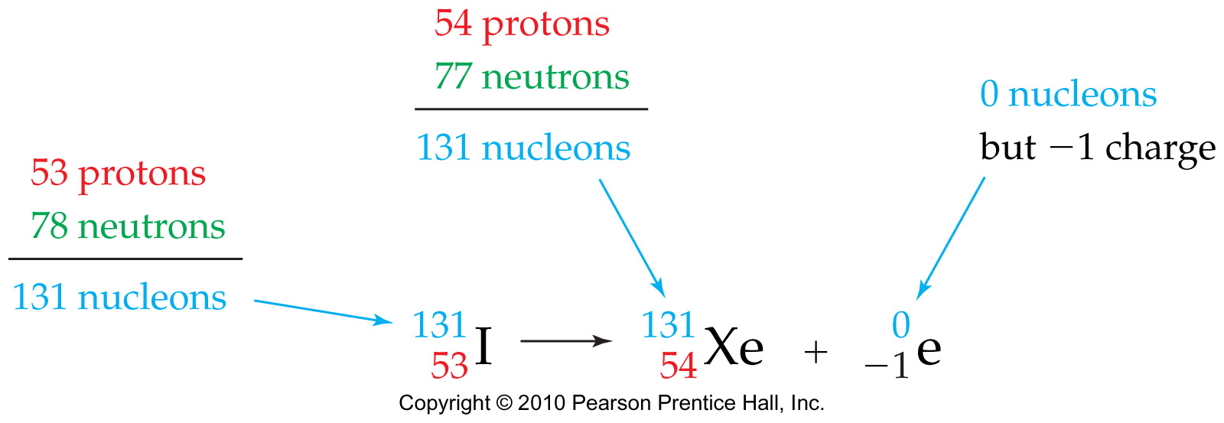
Nuclear Change and Radioactivity
Beta (β) Radiation
A beta particle is an electron.
Beta particle, β–
Notes:
Chapter 2: The Structure and Stability of Atoms
Copyright © 2010 Pearson Prentice Hall, Inc.

Slide 52
Nuclear Change and Radioactivity
Gamma (γ) Radiation
Gamma radiation is simply electromagnetic radiation of very high energy.
Notes:
Chapter 2: The Structure and Stability of Atoms
Copyright © 2010 Pearson Prentice Hall, Inc.

Slide 53
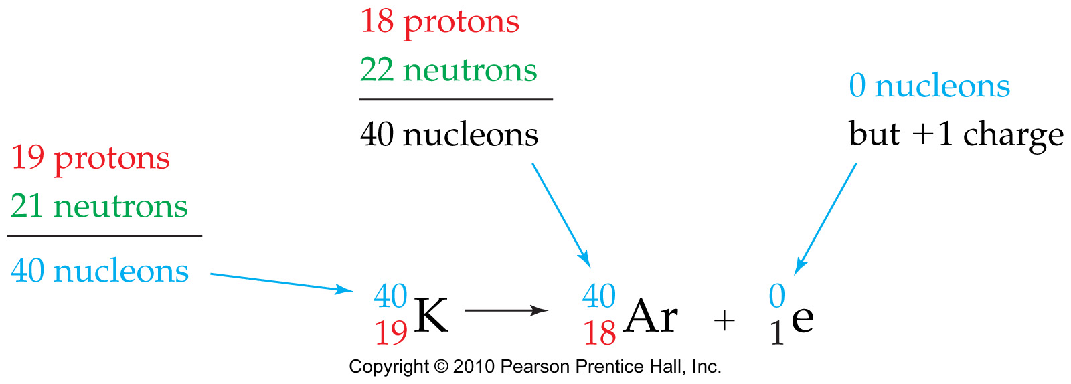
Nuclear Change and Radioactivity
Positron Emission
A positron has the same mass as an electron but an opposite charge. It can be thought of as a “positive electron.”
Positron, β⁺

Slide 54
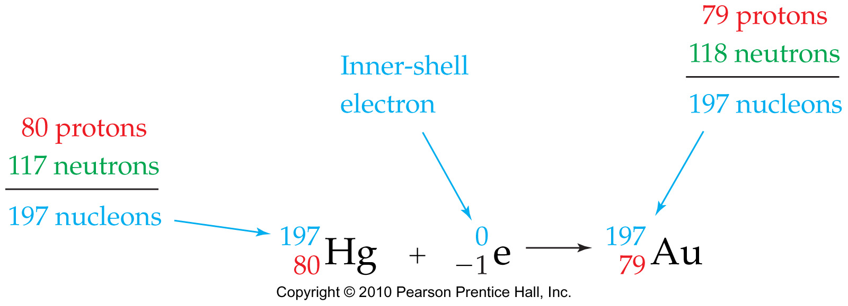
Nuclear Change and Radioactivity
Electron Capture
A process in which the nucleus captures one of the surrounding electrons in an atom, thereby converting a proton to a neutron.
Notes:
Chapter 2: The Structure and Stability of Atoms
Copyright © 2010 Pearson Prentice Hall, Inc.

Slide 55
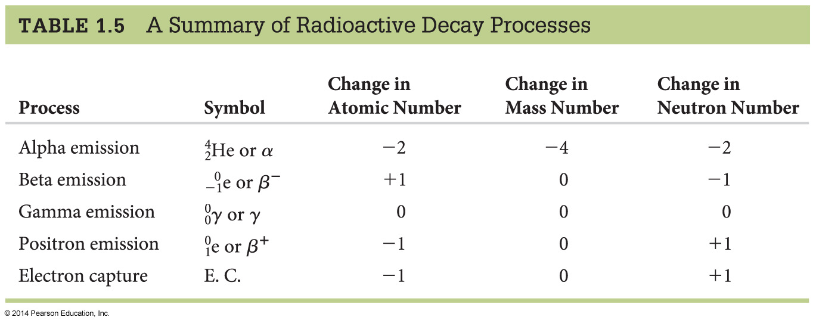
Nuclear Change and Radioactivity
Notes:
Chapter 2: The Structure and Stability of Atoms
Copyright © 2010 Pearson Prentice Hall, Inc.

